Slide 1

TO DEVELOP AN EFFICIENT MODEL FOR SOCIAL RECOMMENDATION SYSTEM

Slide 2
THE PROJECT IS COMPLETED BY-
Aditya Anand - 18365
Bhuswarna Kashyap - 18370
Rahul Nath - 18372
Nidhi Bharti - 18373
Binong Kiri Bey - 18379
UNDER THE GUIDANCE OF PSG FACULTIES-
Dr. G Sudha Sadasivam
Ms. K Vani

Slide 3


WHAT IS A RECOMMENDER SYSTEM?
It recommends the user certain items based on the user’s taste.
It is a system performing information filtering to bring information items such as movies, books, news, images, tools to a user.
A recommendation system also display items that users might not have thought to search for their own.

Slide 4



WHY DO WE NEED RECOMMENDER SYSTEMS?
1. 35% of sales at Amazon arise from recommended products.
2. 38% of click through rates on Google News are recommended links.
3. Almost 67% of movies watched on Netflix are recommended movies.

Slide 5
APPROACH
1
Content Based Approach
Analysing the content of the items being recommended
Each user is treated individually.
2
Collaborative information filtering
Overcome the constraints of Content-based filtering.
Based on collection of taste information from similar users.
Predicts the unobserved preferences of an active user.
4

Slide 6
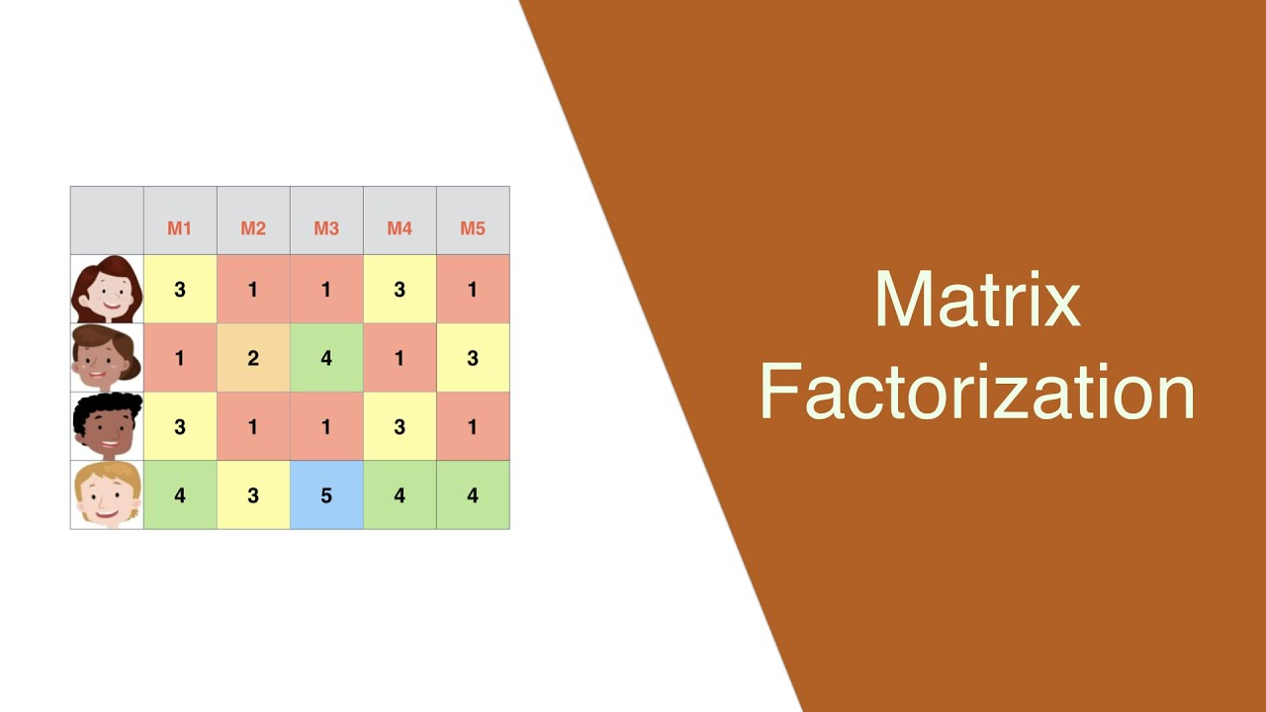
METHOD USED
It is the method by which a matrix is
decomposed to its constituent elements which
makes complex computational matrix
problems easier.

Slide 7
ALGORITHM USED FOR MATRIX FACTORIZATION
1. Single Value Decomposition (SVD):
Used to decrease the dimensionality of the matrix.
2. Alternating Least Square (ALS):
It one of the iterative methods in order to find two matrices X and Y that best approximates the rating matrix R.
3. Weighted Alternating Least Square (WALS):
Weights are introduced in the loss function which vary for the zero and the non-zero entries of the matrix.
4. General Matrix Factorization (GMF).

Slide 8
Normalized Discounted Cumulative Gain (NDCG)
Method for measuring the quality of a set of search results.
It measures how the product is ranked on the basis of its relevance.
The NDCG value is calculated by calculating values of Cumulative Gain
(CG) and Discounted Cumulative Gain (DCG).
Lastly Normalization of DCG is done to have a proper upper and lower
range.

Slide 9
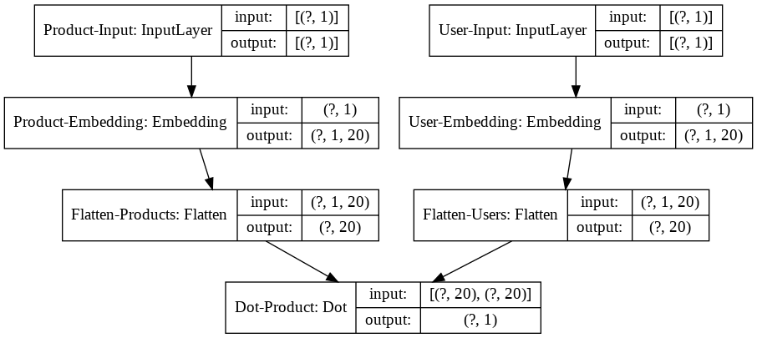
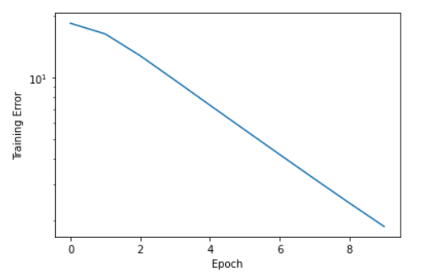
GMF MODEL- TRAINING vs EPOCH GRAPH
Training Error vs Epoch for ‘Adam’ optimiser in the GMF model

Slide 10
GMF MODEL – LOSS FOR DIFFERENT OPTIMISER
Optimizer | Loss at start | Loss at end | Mae at start | Mae at end | Time for each epoch(approx.)
Adagrad | 18.4499 | 18.4477 | 4.1624 | 4.1622 | 6s
Adam | 18.0541 | 0.3843 | 4.1090 | 0.4550 | 155s
RMSprop | 18.4485 | 11.6930 | 4.1623 | 3.0608 | 96s
Adadelta | 18.4498 | 18.4496 | 4.1624 | 4.1624 | 7s
Adamax | 18.4499 | 18.3033 | 4.1624 | 4.1446 | 57s
Nadam | 18.4242 | 7.8622 | 4.1592 | 2.4254 | 146s
Ftrl | 18.4499 | 18.4499 | 4.1624 | 4.1624 | 7s
SGD | 18.4499 | 18.4423 | 4.1624 | 4.1624 | 6s
Latent Factors = 20
Total number of epochs = 10
Table – Loss of all the optimizer with avg. time taken for each Epoch

Slide 11
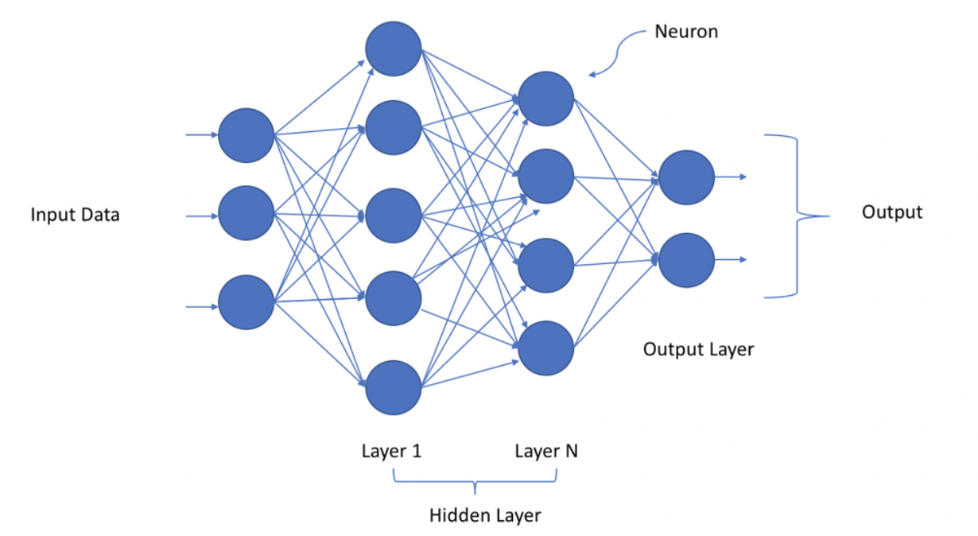
DEEP NEURAL NETWORK
Artificial Neural Network was developed as simulating neurons or networks of neurons
A deep neural network (DNN) is an Artificial neural network (ANN) with multiple layers between the input and output layers.
The neuron takes input in the input layer, does some computations (in the hidden layers) and accordingly produces output through the output layer.
Image courtesy: towardsdatascience.com

Slide 12
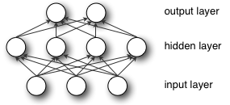
MULTI-LAYER PERCEPTRON
A multilayer perceptron (MLP) is a class of feed-forward artificial neural network.
An MLP (or Artificial Neural Network - ANN) with a single hidden layer can
be represented graphically as follows:
Image courtesy: deeplearning.net

Slide 13
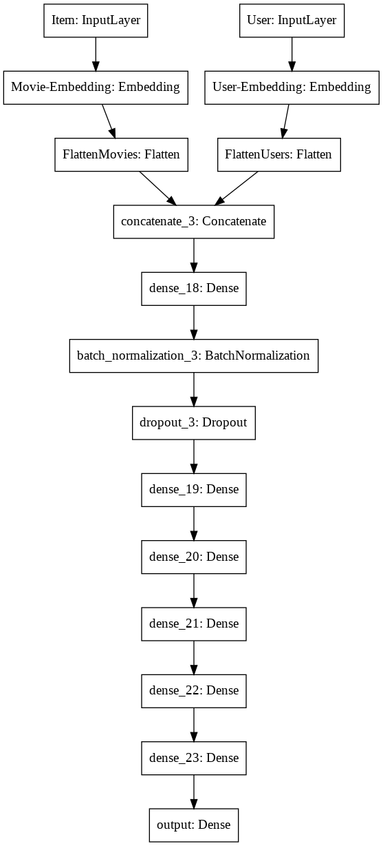
MLP MODEL

Slide 14
MLP MODEL – VALUES FOR DIFFERENT OPTIMISER
Optimizer | Loss at start | Loss at end | Mae at start | Mae at end | Time for each epoch(approx.)
Adagrad | 11.1252 | 11.1252 | 3.1627 | 3.1627 | 237.6s
Adam | 11.1250 | 11.1250 | 3.1627 | 3.1627 | 244.5s
RMSprop | 11.1250 | 11.1250 | 3.1627 | 3.1627 | 358.3s
Adadelta | 11.1252 | 11.1252 | 3.1627 | 3.1627 | 258.9s
Adamax | 11.1250 | 11.1250 | 3.1627 | 3.1627 | 228.8s
Nadam | 11.1250 | 11.1250 | 3.1627 | 3.1627 | 406.7s
Ftrl | 11.1250 | 11.1250 | 3.1627 | 3.1627 | 281.2s
SGD | 11.1252 | 11.1252 | 3.1627 | 3.1627 | 218.7s
Latent Factors = 20
Total number of epochs = 10
Total number of layers in MLP = 6
Activation = ReLU (for the inner layers) and Softmax (for the final layer)
Kernel Initializer = lecun_uniform (for the final layer) and he_uniform (for the rest of the layers)
Table – Loss of all the optimizer with avg. time taken for each Epoch

Slide 15
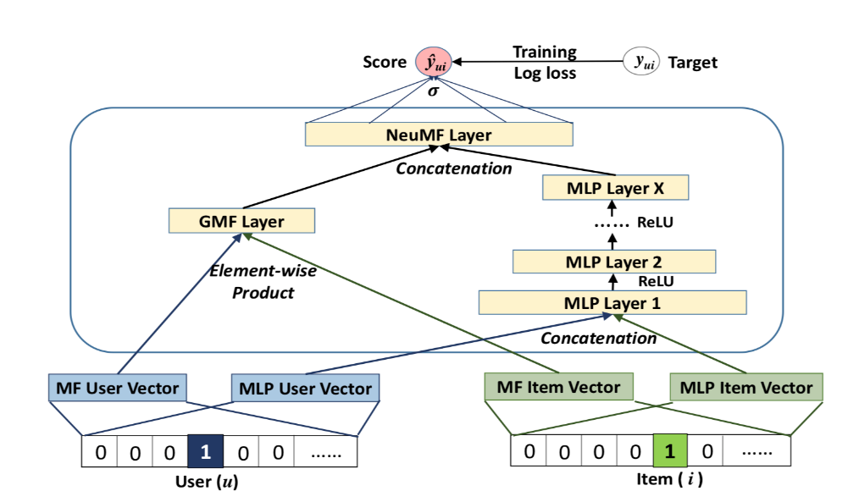
Neural Matrix Factorisation
NeuMF is a more preferred approach for implementing recommendation systems as it supports flexibility and non-linearity of neural networks, and aims at enhancing the model expressiveness.
NeuMF concatenates two sub-networks that is GMF and MLP thus increasing the accuracy of the model
Image courtesy : caravanuden.com

Slide 16
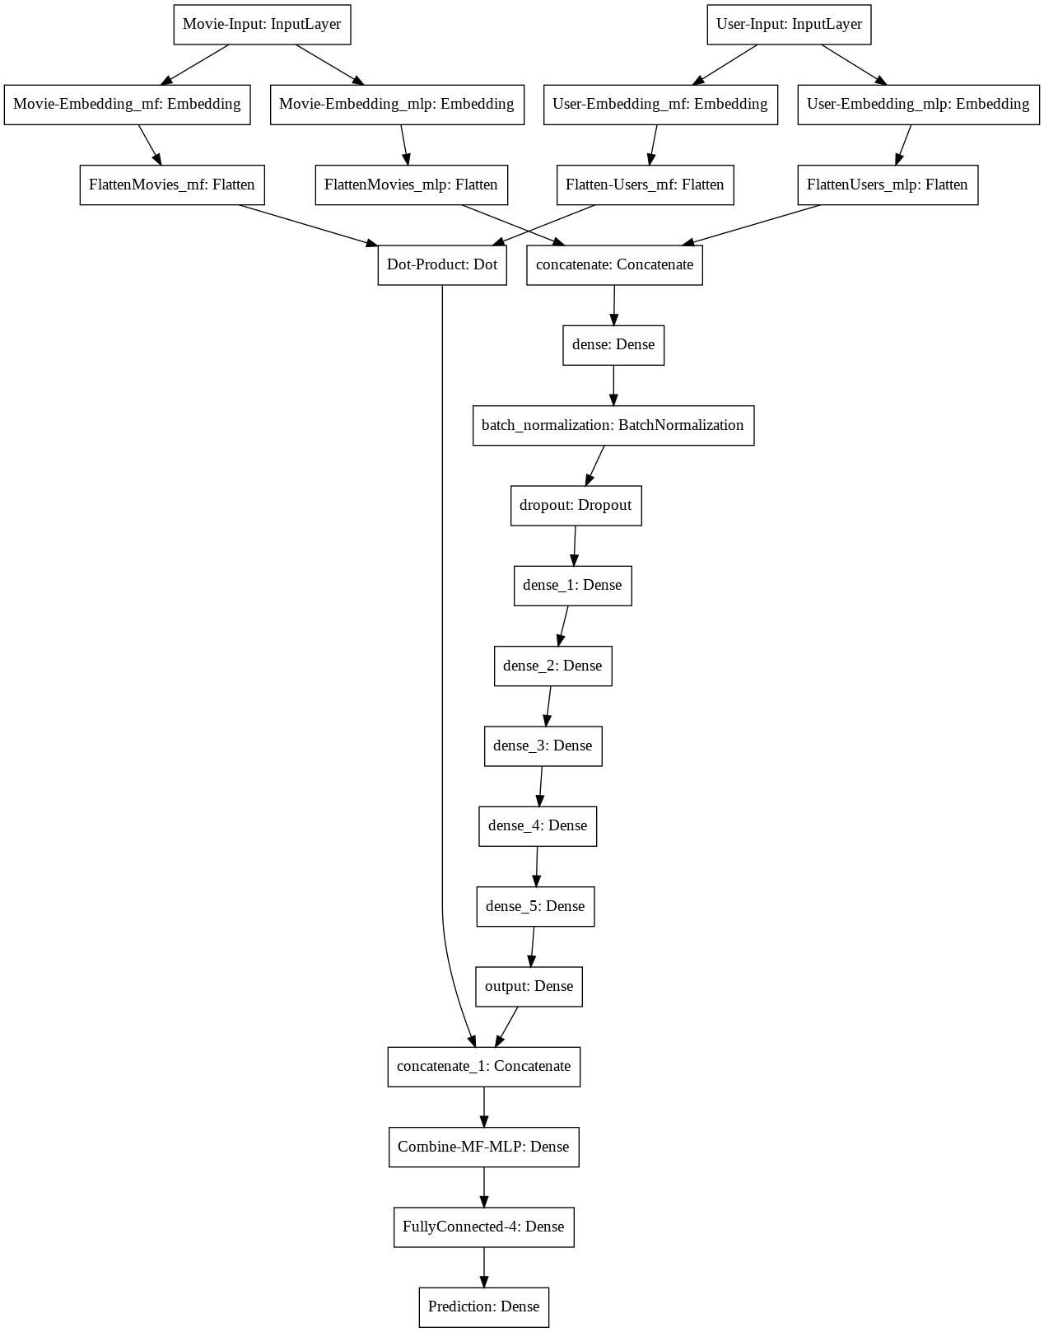
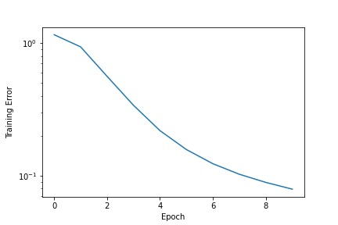
NeuMF Model and TRAINING vs EPOCH GRAPH
Training Error vs Epoch for ‘Nadam’ optimiser in the NeuMF model

Slide 17
NeuMF MODEL – VALUES FOR DIFFERENT OPTIMISER
Optimizer | Loss at start | Loss at end | Mae at start | Mae at end | Time for each epoch(approx.)
Adagrad | 1.2364 | 1.1253 | 0.8528 | 0.8203 | 263.8s
Adam | 1.1589 | 0.0972 | 0.8280 | 0.2371 | 456.2s
RMSprop | 1.1551 | 0.2127 | 0.8289 | 0.2975 | 438.6s
Adadelta | 7.7832 | 1.1253 | 2.3172 | 0.8203 | 259.8s
Adamax | 1.1505 | 0.8543 | 0.8259 | 0.6916 | 278.8s
Nadam | 1.1562 | 0.0792 | 0.8276 | 0.2006 | 475.1s
Ftrl | 1.4667 | 1.1244 | 0.9079 | 0.8203 | 278.7s
SGD | 1.1427 | 1.1286 | 0.8239 | 0.8202 | 193.7s
Latent Factors = 20
Total number of epochs = 10
Total number of layers in MLP = 6
Activation = ReLU (for the inner layers) and Softmax (for the final layer)
Kernel Initializer = lecun_uniform (for the final layer) and he_uniform (for the rest of the layers)
Table – Loss of all the optimizer with avg. time taken for each Epoch

Slide 18
Conclusion
Thus from the value of the losses from the three models we can infer that MLP or GMF alone is not that accurate or suitable model for the recommendation. Whereas when we used the amalgamation of the two models that is the NeuMF model we saw that the loss(1.5200) seen is significantly lower than that of MLP(11.08) and GMF (7.08) when performed on the test set.

Slide 19
Thank you

